Slide 1
Power control and tdma design configuration

Slide 2
Agenda
Motivation
Overview
Definition of Power Control
Path Loss and Slow Fading
Simulation Results
Conclusions
Acknowledgements

Slide 3
Motivation
The cellular communications market is experiencing great technological progress and development.
The project focuses on one of the techniques involved in cellular systems whose purpose is to help increase system capacity -
POWER CONTROL

Slide 4
Overview
Studying the issues concerning propagation and path loss scenarios.
Studying different power control strategies.
Proposing a propagation model based upon different environment conditions.
Creating a computer simulation that tests the path loss model.
Finding criterion for power control on basis of simulation.

Slide 5
Introduction to Cellular Communication
In cellular systems, the service area is divided to cells.
Each cell uses a specific set of frequencies.
Cellular systems implement frequency reuse in service area.
For example: cells with the same letters use the same set of frequencies.

Slide 6
Definition of Power Control
A mechanism that allows managing the transmitted power on a cellular link.
The control can be downlink (base - station power) or uplink (mobile power).
Power is controlled according to measurements and decisions done by each end point.

Slide 7
The Goals of Power Control
Generally - provide each subscriber with sufficient connection quality, for any cellular link condition.
Compensate for channel degradation - fading or attenuation, specifically for each subscriber.
Reduce power consumption by the mobile terminal.
Example: the ‘Near - Far Effect’ in CDMA.

Slide 8
Near Far Effect (CDMA example)
CDMA systems use adjacent code channels.
These channels use same frequency, and differ by orthogonal ‘spreading codes’.
The receiver at the base station uses the codes to separate the signals from each other.
C1
C3
C2

Slide 9
Near Far Effect (Continued)
U1 is transmitting close to a base station and U2 is transmitting from further away.
Without any power management, U1 signal could interfere and mask out U2 signal.
X dBm
X dBm
Y dBm
U1
U2
Power control will minimize interference between the mobiles in the cell.

Slide 10
Definition of Path Loss
The major characteristic of a wireless communication channel is Path Loss, measured in dB.
This parameter describes the difference in signal power between two measuring points (T, R).
Building reflection
P₁
LOS
P₂
Ground reflection

Slide 11
Path Loss and Fading
Research has found that environmental conditions largely affect the Path Loss measured in cellular systems.
Path Loss is a result of phenomena such as signal attenuation and fading.
Attenuation increases with the distance.
Fading is actually fluctuation of signal amplitude due to propagation effects.
There is slow and fast fading.

Slide 12
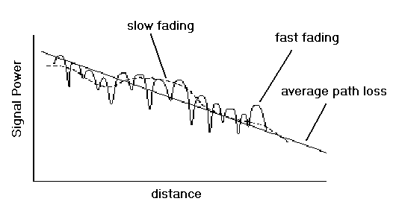
Slow Fading (Shadowing)
Slow fading is the change in signal power or amplitude caused by obstructions in the path.
Increases in ‘shadowed’ regions.

Slide 13
Causes of Slow Fading
Scattering, reflection and diffraction.
Reflection
Diffraction
Scattering

Slide 14
Simulation Results
Slow Fading in different environment profiles.
Total path loss in different environment profiles, with dependency on:
distance
receiving antenna height
average building height
Signal to noise ratio - SNR, depending on distance
Percentage of shadowed regions within a cell

Slide 15
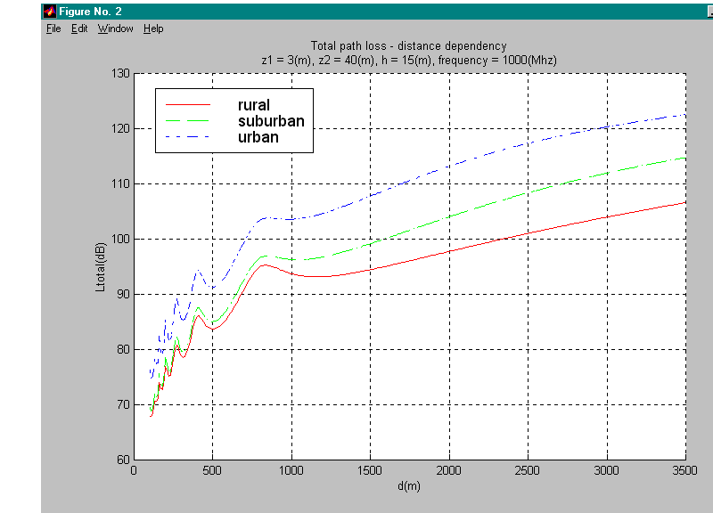
Total Path Loss Vs. Distance
Max Path Loss ≈ 123dB (at 3.5Km)

Slide 16
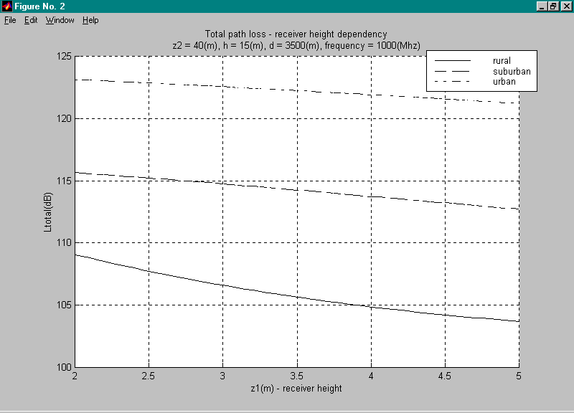
Total Path Loss Vs. Receiver Height
Path loss is reduced as receiver is raised

Slide 17
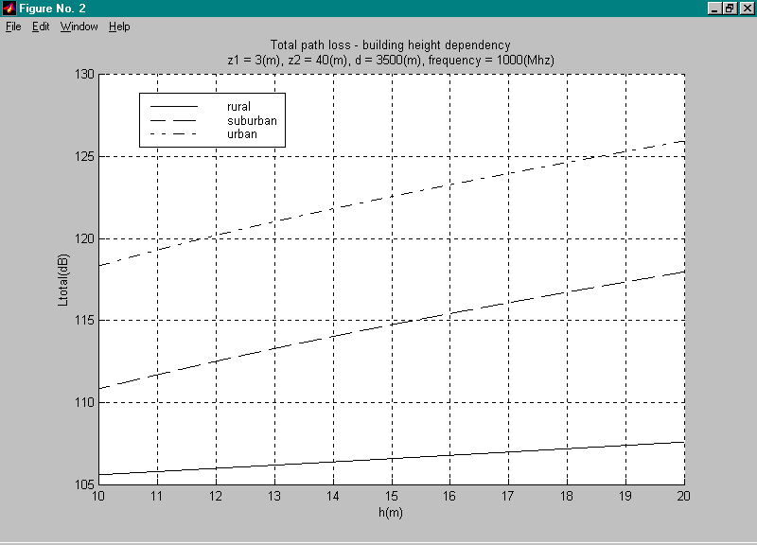
Total Path Loss Vs. Building Height
Path loss increases as average building height increases

Slide 18
Application of Power Control
Any mobile within the cell, which experiences path loss above MAPL, should be given more power on its link.
At a mobile that experiences path loss below MAPL, the SNR should be measured for fine modifications of power.

Slide 19
Application of Power Control (2)
Path loss (L)
L > MAPL
Request base for more power
L = ?
L < MAPL
SNR < 1
Request fine modification
SNR = ?
SNR > 1
Do nothing

Slide 20
Conclusions
Propagation simulation estimates path loss for different environment profiles.
Path loss gives criterion for power control decision for each subscriber.
Simulation also estimates SNR at the mobile, indication for signal quality.

Slide 21
Acknowledgements
Propagation model based upon research of Proffesor Natan Blaunstein.
We would like to thank Prof. Blaunstein for the guidance in this project!

Slide 22
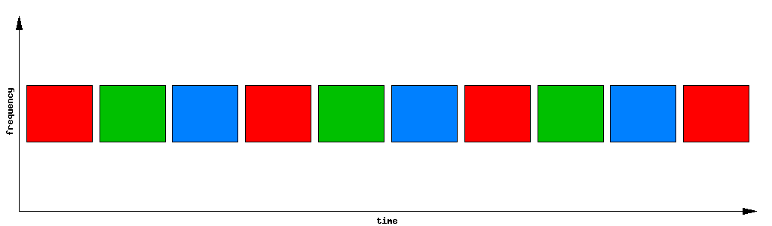
TDMA
Time Division Multiple Access
Design configuration

Slide 23
Outline
▶ What is TDMA
▶ TDMA frame structure
▶ TDMA architecture
▶ Advantage of TDMA
▶ Disadvantage of TDMA

Slide 24
What is TDMA?
▶ Time Division Multiple Access
▶ Digital wireless telephone transmission technique
▶ Allocates the given bandwidth for different users in different time slots
▶ Each user is allowed to transmit only within specified time intervals (Time Slots).
▶ When users transmit, they occupy the whole frequency bandwidth

Slide 25
Example of TDMA

Slide 26
TDMA frame structure
Frequency
Frame Frame
Frame
#1
#2
…
#n
#1
#2
…
#n
#1
#2
…
#n
Time
Guard time
Head
Data

Slide 27
TDMA architecture
VLR
AUC
MSC
HLR
VLR
PSTN
MSC
EIR
VLR
MSC
BSC
BS
BS
BS
BTS
Common radio interface
MS
MS

Slide 28
Mobile Station (MS)
▶ The MS is the mobile handset, it contains the ME and the SIM
▶ Mobile equipment (ME)
▶ mobile handset hardware, including RF, GSM modulation etc
▶ Identified by a unique International Mobile Equipment Identity (IMEI) (different from the phone number)
▶ Subscriber Identity Module (SIM)
▶ contains subscriber-related information
▶ Identified by a unique International Mobile Subscriber Identity (IMSI) (different from the phone number)

Slide 29
Base Station Subsystem (BSS)
▶ The BSS consists of BTSs and BSCs
▶ Base Transceiver Station (BTS)
▶ responsible for communication with the MS
▶ responsible for radio transmission and reception
▶ includes antennas, modems, signal processing
▶ Base Station Controller (BSC)
▶ responsible for radio interface management of BTS and MS,
i.e. channel management and handovers
▶ responsible for communication with the NSS
▶ a single BSC typically manages 10-20 BTSs

Slide 30
Network and Switching Subsystem (NSS)
▶ NSS contains the switching functions of TDMA, as well as databases for mobility management
▶ NSS contains
▶ Mobile Switching Centre (MSC)
▶ Home Location Register (HLR)
▶ Visitor Location Register (VLR)

Slide 31
NSS cont’d...
▶ Mobile Switching Centre (MSC)
▶ coordinates setup of calls to and from GSM users
▶ controls several BSCs
▶ Home Location Register (HLR)
▶ contains information about subscribers, e.g. subscriber profiles, also information on their current location
▶ IMSI, user phone number, address of current VLR etc
▶ Visitor Location Register (VLR)
▶ temporarily stores subscription data for subscribers currently in the (G)MSC area
▶ contains more precise location data than does the HLR
▶ linked to one or more MSCs

Slide 32
Advantage of TDMA
▶ A single channel can be used by multiple user
▶ TDMA can be used instead of analog duplex filter with time switch
▶ The number of radio transceiver can be reduced and the cell size can be much smaller
▶ TDMA is most cost effective technology to convert analog system to digital

Slide 33
Disadvantage of TDMA
▶ TDMA require the accurate clock
▶ Inaccurate clock for transmitter and receiver results in time jittering
▶ It causes multipath distortion

Slide 34
Thank you…

